Slide 1
Establishment of ICT Infrastructure of the Member States
by Providing ICT Equipment
Soo Youn Hwang
Project Officer, Programme Division
RCARO

Slide 2

01
Background
02
Status of Member States
03
Objectives & Process
04
Discussion

Slide 3
1. Background
The communication and information flow amongst the RCA community should be kept facilitated and vitalised
As yet, some MSs have limited communication infrastructures such as computer availability for an exclusive use for RCA matters

Slide 4
2. Status of Member States
RCARO’s previous Support of Communication Infrastructure for MSs
- Overview
RCARO provided communication infrastructures such as computers and printers to MSs for an exclusive use of the RCA matters
- History
In 2004 : 2 sets of high-tech computers with LCD monitors and laser printers respectively to BGD, MYA, PHI and SRL
In 2005 : 2 computers and a laser printer respectively to INS, MON, THA, and VIE
In 2006 : 1 laptop respectively to THA, PHI and INS

Slide 5
2. Status of Member States
Status of MSs
It is understood that some Member States still have difficulties in fulfilling RCA works due to lack of communication infrastructure

Slide 6
3. Objectives & Process
Objectives of the ICT Infrastructure Support
Increase and facilitation of communication and information flow amongst RCA personnel and/or RCA project participants and further support the establishment of ICT infrastructure of Member States
- Support of the video conferencing system may be considered in the long term
Procedure
Setting up the basic picture of the programme through constitution of a working group
Refinement of the plan in consultation with NRs and SAC through e-communication and report it to the NRM and GCM
Securing of the fund from the host country
- Budget may be available in 2015 upon approval of the plan by the host country

Slide 7
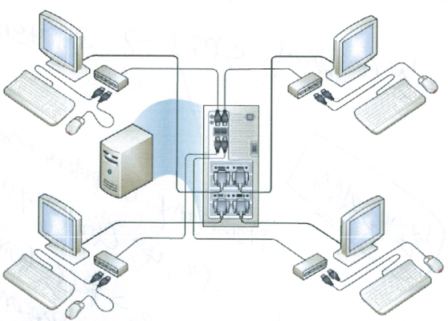
4. Discussion
Consideration on;
What to support?
- Hardware : computers or Clouding system* ?
* Clouding system: a network computing system that can use 1 computer through up to 6 connected monitors at the
same time
- Software : whether to provide any RCA related software to
support RCA personnel and/or RCA project participants together with the hardware;
Do we have such software?
Do we need to develop a software?
Who to support? (incl. selection criteria)
- ex) RCA office in MSs, Institutions related with RCA projects

Slide 8
4. Discussion
Consideration on (cont’d);
How many HW/SW are needed?
Other comments and suggestions, etc.
Constitution of Working Group

Slide 9

Thank You

