Slide 1
RCARO
Past, Present, Future
In-House Evaluation & Thoughts on RCARO Activities
(Kun Mo CHOI, Director,
Seoul, RCARO Workshop, Aug. 2013)

Slide 2
Background
Dr. Dongxin Feng’s suggestion
- To address means to further enhance the role of RCARO in response to demands from the IAEA and Member States
10 Year’s anniversary of RCARO
Past – Present - Future

Slide 3
Ten Year’s of History
March 2002: Establishment of the RCARO for interim operation in Daejeon, ROK
The 32nd GCM in 2003 adopted the resolution on the Establishment of the RCARO
The 27th NRM in 2005 decided full operation of the RCARO and appointed Director of RCARO
The 36th GCM in 2007 adopted the resolution on the roles and status of the RCARO
March 2012: the 10th Anniversary of the RCARO

Slide 4
Changes in the Past 10 Years
Mission:
  To seek out opportunities to participate in the projects of other regional and international agencies
  To negotiate and secure funding for RCA projects
  To promote peaceful uses of nuclear tech.
  To enhance visibility of RCA
  To implement agreed directives by the Member States
  To provide Member States with RCA related records as a repository (at the 39th GCM)

Slide 5
Changes in the Past 10 Years
Budget
  0.5 Mil. USD  1.17 Mil. USD

Slide 6
Changes in the Past 10 Years
Personnel
  6 regular staff -> same
  Temp. staff from Member States

Slide 7
Changes in the Past 10 Years
Operation & legal status
  Interim operation (2002-2005)  Full operation (2005-present)
  Resolutions to support the Office’s status
    1st (2003, 32nd GCM): A resolution on the establishment of the RCARO; It reconfirmed roles and functions of the Director of the RCARO.
    2nd (2007, 36th GCM): A resolution on the roles and status of RCARO; It confirmed that the Director of the RCARO has the authority to act on behalf of the RCA in order to fulfil its mandate given by the RCA Member States, as set out in the RCA Guidelines and Operating Rules

Slide 8
Changes in the Past 10 Years
Oversight Bodies: SAC and SC
  Standing Advisory Committee (in RCA): discuss, advise and decides on major issues
    ROK-NR(host country), Past, Present, Upcoming Chairs, IAEA Focal Person
  Steering Committee (in host country): discuss, advise and decides on RCARO work plan & budget
    MSIP, RCARO related experts in Korea (11 members)
      ** MSIP: Ministry of Science, ICT and Future Plan

Slide 9
Changes in the Past 10 Years
Relationships among RCARO stakeholders
Budget
Office
MSIP
SC
National
Assembly
RCARO
SAC
IAEA
RCA Member States
: organizations in the host country

Slide 10
Major Achievements

Slide 11
Seeking Partnerships & Fund
Major Achievements
Dr. Aleta’s study (Aug.~Sept. 2005)
  Visited FAO, UNESCAP, UNIDO, UNESCO, UNEP, AIT, UNDP, ADB, PEMSEA, etc.
  biennial programs, MDGs, partnerships, No-nuclear policy
  Suggestion:
    Short term: FAO, UNESCAP, AIT, PEMSEA
    Medium term: ADB, ASEAN, UNEP
    Long term: UNESCO, UNICEF, UNIDO
RCARO visited UNDP, UNESCAP, PEMSEA, UNEP, ADB
UNDP/RCA programs were initiated.
ARCCNM/RCARO partnership was developed.
  * ARCCNM: Asian Regional Cooperative Council for Nuclear Medicine

Slide 12
Major achievement
Promote peaceful uses of nuclear technologies
  RCARO/KAERI Regional Training Workshop
  RCARO/KAIST Nuclear Engineering Master’s Degree Course
  Participation in FNCA (Forum for Nuclear Cooperation in Asia) to discuss the cooperation with RCA since 2009, representing RCA Member States

Slide 13
  Awareness of RCA
Major Achievements
Operation of RCA website
RCARO incorporated the MOH website in MAL in 2010
The degree of access to the website data for public was decided at the 39th GCM in 2010
RCARO renewed the RCA website in July 2011
RCA Success Story : RCARO has published total of 18 Success Stories (15 leaflets + 3 booklets) throughout 5 batches of publication
Participation in international meetings by RCARO or experts from Member States
Exhibition at the 40th anniversary of RCA (2012)
Production of RCA promotion video (2011)

Slide 14
  Member States’ Directives from NRM, GCM, SAC, NRs
Major Achievements
Success story
RCA website
Annual RCARO Work Plan

Slide 15
  RCA’s Repository
Major Achievements
Various RCA documents such as NRM, GCM records, information on RCA projects are stored in RCA web site(www.rcacro.org).

Slide 16
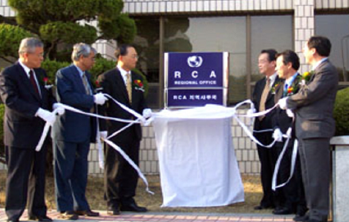

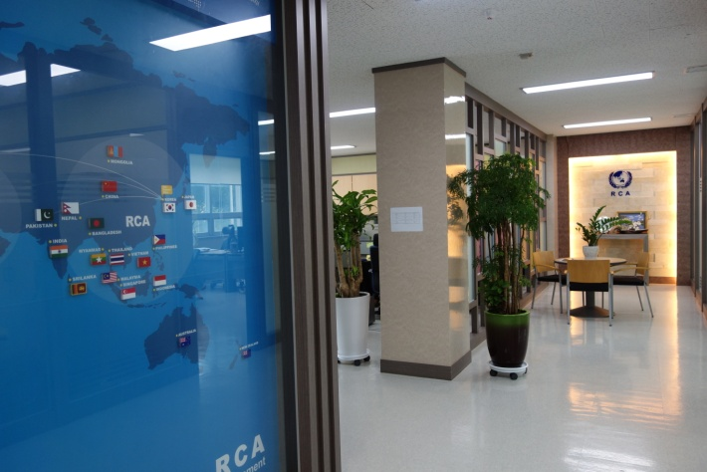
Major achievement
Operation
  Increase in its budget
  Environment of the Office
  Enhancement of its legal status
Opening of RCARO in ‘02
Relocation of RCARO in ‘07
Relocation of RCARO in ‘13

Slide 17
Evaluation
IAEA’s report on the RCARO’s performance before its entering into full operation in 2005
  It said that RCARO had established administrative and legal provisions for its operation and fulfilled its mandate to a large extent.
  Awarded Certificate of Excellence on its RCA promotional and information programme in 2013 from IAEA/TC
SAC’s annual evaluation
Member States’ evaluation (at NRM, GCM)
Host country’s evaluation
  By SC
In-house evaluation

Slide 18
Issues and challenges ahead
Some worrying indicators
  Budget, Manpower
  Support from the host country
  Support from RCA
Is the present mission proper?
  Focused on viability and visibility – Is it enough and proper?
Budget and manpower?
  Are they enough and stable?
Is this an international body?
  Lack of legal protection and autonomy in operation

Slide 19
Thoughts on future
Mission
  Partnership with other org.
  Securing fund for RCA projects
  Promotion of NT
  Awareness
  Directives from Member States
  Repository of information
  (Suggestion) Support of tasks related with the RCA projects

Slide 20
Thoughts on future
Legal provisions for RCARO
  Present Agreement + article on the establishment and basic structure of RCARO
  (an alternative) RCA/IAEA Regional Office (bench marking UNDP/IAEA Regional Industrial Project Office in INS)

Slide 21
Thoughts on future
RCA/IAEA Regional Office, referring to UNDP/IAEA Office in INS in 1983-1992
(a proposal for discussion)
 | UNDP/IAEA Regional Industrial Project Office in INS | RCA/IAEA Regional Office in ROK
Fund | UNDP (Regional Industrial Project) Gov’t, Industry | -ROK -Other Member States -Int’l Org.
Mission | UNDP/RCA projects | -RCARO program(partnership, awareness, support of RCA projects)
Period | July 1983 ~ 1992
Legal frame | Agreement between IAEA & INS | Agreement between IAEA & ROK
Staff | -Rep. and a staff (IAEA) -secretaries (BATAN) | -Dir. and staff (IAEA)
Office Status | -office in BATAN | -an independent body in ROK
Operating cost | -provided by BATAN | -provided by fund

Slide 22
Basic Direction for the future of RCARO
For the benefit of all Member States
Entity to promote nuclear techniques in the region through cooperation
Use of given recourses of the RCARO (budget, manpower, experience)
Interests from the high decision makers in Member States are essential to solve the challenges ahead of RCARO.
We need to devise strategy to make all stakeholders (Agency, Member States, Host country of RCARO) winners.

Slide 23
Thank you.

