Slide 1
2013 Annual Report and
Working Plan for 2014
RAS/5/057
LLC: Ms. Gao Meixu
Chinese Academy of Agricultural Sciences

Slide 2
Basic information
Project Name
  Implementing Best Practices of Food Irradiation for Sanitary and Phytosanitary Purposes
Implementation Period
  2012-2014
Leading Country Coordinator (LCC)
  Meixu GAO, Chinese Academy of Agricultural Science

Slide 3
Objective
Enhance the effective application of irradiation technologies for sanitary and phytosanitary purpose of agricultural products.

Slide 4
Expected output
Effective project planning, coordination and implementation.
Compiled information on different irradiation technologies (gamma, electron beam, X-ray) for food irradiation specialist and regulatory officials.
Adopted training modules on sanitary and Phytosanitary .
Enhanced technical capacity, knowledge and understanding of irradiation technologies.

Slide 5
Participating MS (17)
Australia
Bangladesh
China
India
Indonesia
Japan
Malaysia
Mongolia
Myanmar
Nepal
New Zealand
Pakistan
Philippines
Republic of Korea
Sri Lanka
Thailand
Vietnam.

Slide 6
2012 Regional Activities
Project Planning Meeting
  March 26-30, 2012, Hanoi, Vietnam
Expert services for phythosanitary
  Completed in Sep. 2012
Workshop on best practice for phytosanitary applications of food irradiation
  Oct. 22-26, 2012, Jeongeup, Republic of Korea.

Slide 7
2013 Regional Activities
Expert services for sanitary
  compiling information and writing a report which summarizes best practice on sanitary.
  Completed in April, 2013
Workshop on best practice for sanitary applications of food irradiation.
  Organized in Shanghai, China, May 6-10, 2013
  Co-hosted by Shanghai Academy of Agricultural Science, 40 participants
  Organized a three-day national workshop of 50 participants on food irradiation processing

Slide 8
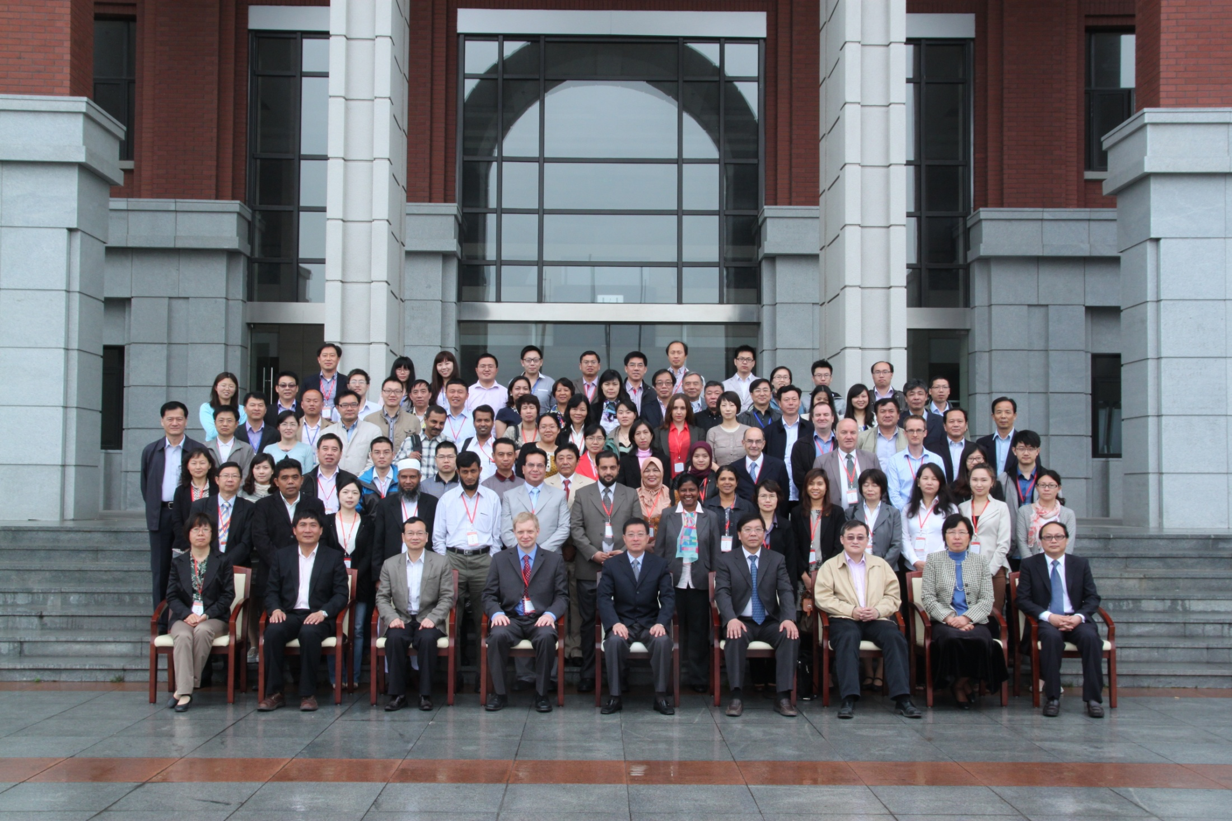

Slide 9
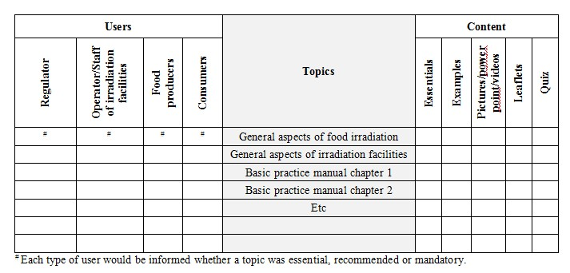
2013 Regional Activities
Expert Meeting drafting the training module for sanitary and Phythosanitary applications of food irradiation
Implemented together with Shanghai workshop in May, 2013

Slide 10
2013 Regional Activities
Executive Management Seminar on best practices for sanitary applications of irradiation as a quarantine treatment
Held in Malaysia，28-31 Oct 2013
facilitating information exchange between public health officials and food irradiation specialists.

Slide 11
2013 MS National Activities
Bangladesh
Plant Quarantine Department of the Ministry of Agriculture agreed to emphasize on the use of radiation for sanitary and phytosanitary purpose. Monitoring of IAEA on the food irradiators globally is important with mechanical/dosimetric assistance.
China
5 commercial EB machines are under construction and will be used for food irradiation. New national standards was drafted in 2014. A new national TC project is carried out to evaluate the existing national standards related to food irradiation based on the final Best Practice Manual that RAS 5057 developed.

Slide 12
2013 MS National Activities
The Philippines
As a result of the Shanghai Meeting, the PNRI and the Bureau of Food Product Standard (BAFPS), Department of Agriculture agreed to create a technical working group composed of different agencies involved in food irradiation in coming up with a Standard Manual regarding Best Practice on Food irradiation in the Philippines. The said Standard will be based on the final Best Practice Manual that Member States of RAS 5057 developed.
New Zealand
A project has been initiated to develop a business plan for significant upgrading of radiation facilities at ESR, Christchurch that is expected to provide better facilities for food irradiation trials and training.

Slide 13
2013 MS National Activities
Sri Lanka
With the technical support of IAEA, the first commercial Co-60 irradiator was operated in 2013. Foods including spices will be irradiated .
Other MSs
Information from this project has been disseminated to commercial operators, and state and federal agencies.

Slide 14
2014 Planed Activities
Med-term review meeting, Australia, May, 2014
Expert Services
  Development of a review report on gamma, E-beam and X-ray irradiation, benefits and drawbacks. It will be completed in 2014 as planned.

Slide 15
2014 Planed Activity
Executive Management Seminar on best practices for phytosanitary applications of irradiation as a quarantine treatment (facilitating information exchange between quarantine officials and food irradiation specialists).
PRO: sub-contract to produce E-Learning courses on the IAEA website, including training course module documents and PowerPoint presentations
Final review meeting, 1st Quarter of 2015

Slide 16
THANK YOU FOR YOUR ATTENTION

